Slide 1
Crime Detection
V.V.S.N.SAI MOHAN(20275)
M.VISHAL REDDY(20248)
B.HEMANTH(20215)
S.MANIKANTA(20268)
B.J.THARAKA(20217) K.NAVEEN KUMAR(20238)

Slide 2
PROBLEM DEFINITION
This project is focused on creating a model that can help predict the type of crimes in Washington DC. The Washington DC Metropolitan Police Department keeps track of crime incident reports in the city and uploads them to DC Open Data for public consumption. Prediction is done using these data and their performance is evaluated by using accuracy score and confusion matrix. [https://opendata.dc.gov/search?q=crime%20dataset]

Slide 3
Dataset Information
In our dataset initially we are having 25 features.
1 | CCN | A unique identifier assigned by MPD to each incident report.
2 | REPORT_DAT | The date the offense was reported to MPD
3 | SHIFT | MPD member's tour of duty associated with the time the report was taken. Day shift generally runs between 07:00 and 15:00 ; evening shift between 15:00 and 23:00, and midnight shift between 23:00 and 07:00. If the shift is unknown, the field will say "UNK".
4 | METHOD | Type of weapon used to commit crime.
5 | OFFENSE | Type of crime which had occurred

Slide 4
6 | BLOCK | Block Name bases on its Theoretical Address Range from MAR Geocoder
7 | XBLOCK | Block X coordinate (centroid) of crime incident from MAR Geocoder
8 | YBLOCK | Block Y coordinate (centroid) of crime incident from MAR Geocoder
9 | WARD | District Ward Identifier : Ward ID from from MAR Geocoder
10 | ANC | Advisory Neighborhood Commission Identifier : ANC ID from MAR Geocoder
11 | DISTRICT | Police district from MAR Geocoder
12 | PSA | Police Service Areas : PSA ID from from MAR Geocoder

Slide 5
13 | NEIGHBORHOOD_CLUSTER | Neighborhood Cluster from MAR Geocoder
14 | BLOCK_GROUP | Census block group from MAR Geocoder
15 | CENSUS_TRACT | Census track from MAR Geocoder
16 | VOTING_PRECINCT | Voting precinct from MAR Geocoder
17 | X | X Coordinate of crime incident from MAR Geocoder
18 | Y | Y Coordinate of crime incident from MAR Geocoder
19 | LATITUDE | Latitude of Crime Incident from MAR Geocoder
20 | LONGITUDE | Longitude of Crime Incident from MAR Geocoder

Slide 6
21 | BID | Business Improvement Districts
22 | START_DATE | Crime incident start date and time
23 | END_DATE | Crime incident end date and time
24 | OBJECTID | Internal feature number : Sequential unique whole numbers that are automatically generated.
25. | OCTO_RECORD_ID

Slide 7
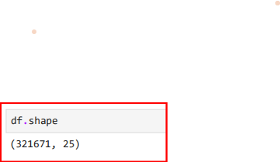
Data Exploration
Dataset consist of 321671 instances and 25 features.

Slide 8
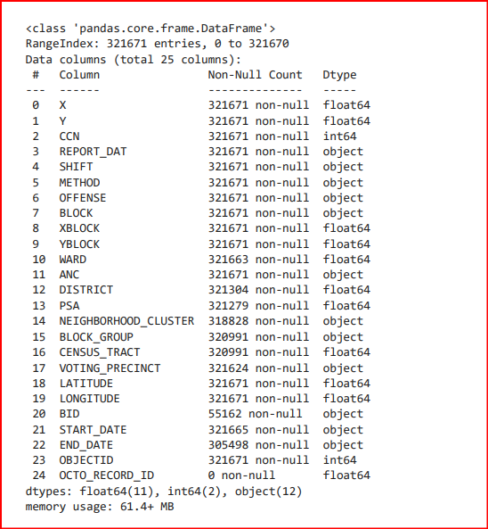
Data Exploration
The data types are int ,float and string
We have done this by data.info()
11 columns contains null values
There is no duplicates rows but duplicate columns are present

Slide 9
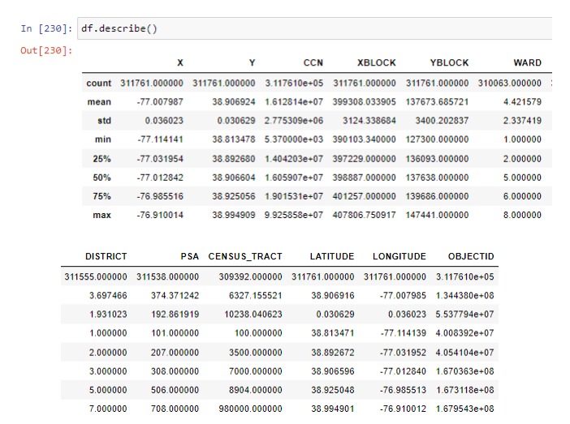
The describe() method is used for calculating some statistical data like percentile, mean and std of the numerical values of the Series or DataFrame. It analyzes both numeric and object series.

Slide 10
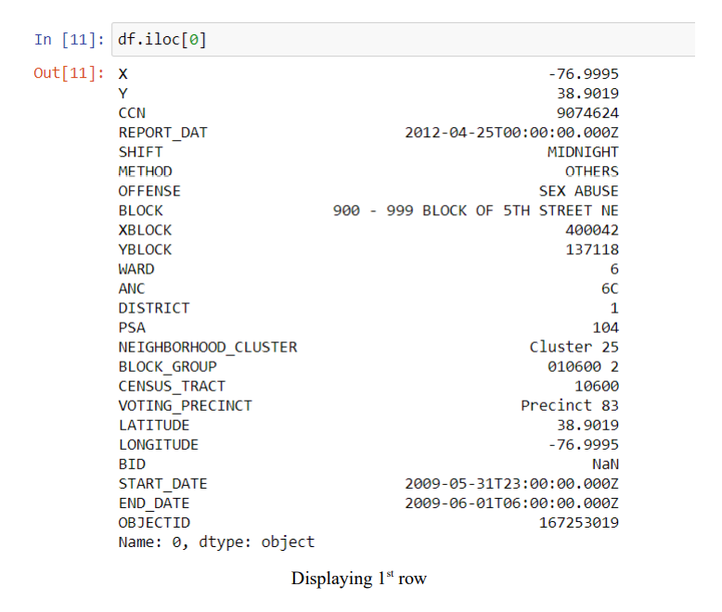

Slide 11
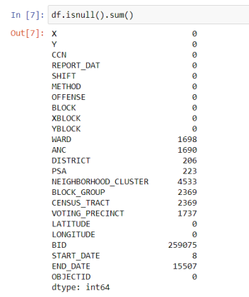
Data Cleaning
Inputting missing values:
11 columns with missing values.
Excluding the column BID, total number of datas with null value is very much lesser than the total number of data present in dataset.
nullvalues

Slide 12
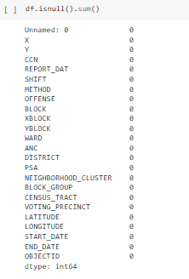
So we removed all the rows with null value without considering the null values in the column BID thus making a dataset containing 291069 rows
Almost 75% of data in BID is null value,
so it is better to remove that column
for prediction
Now our data is free from null values

Slide 13
Removing unwanted parts from columns:
For each value of VOTIING_PRECINCT we can see that “Precinct “ is added before the number
For each value of NEIGHBORHOOD_CLUSTER we can see that “Cluster “ is added before the number
Removing “Precinct “ and “Cluster “ from each record of VOTIING_PRECINCT and NEIGHBORHOOD_CLUSTER

Slide 14
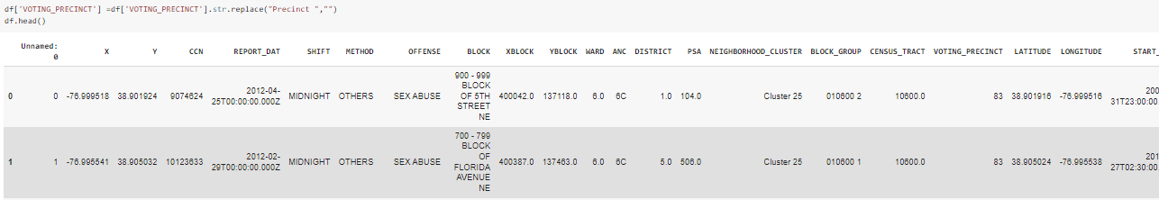
For each value of VOTIING_PRECINCT we can see that “Precinct “ is added before the number
Before correction
After correction

Slide 15
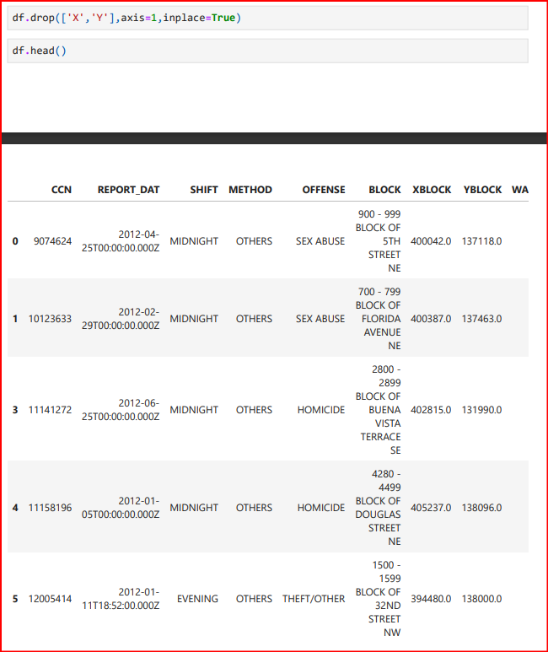
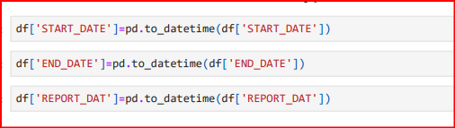
Values in column X and Y is same as that of column Latitude and Longitude So we are dropping X and Y
Also data are represented as object type, it should be converted into data time datatype.

Slide 16
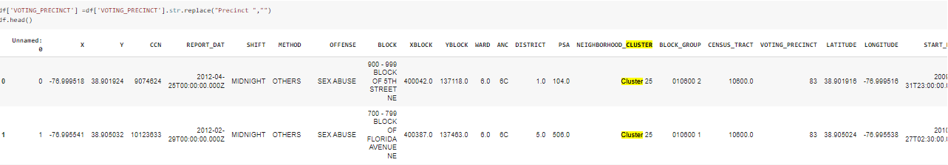
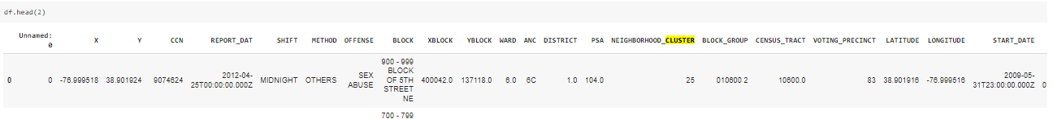
For each value of NEIGHBORHOOD_CLUSTER we can see that “Cluster “ is added before the number
Before correction
After correction

Slide 17

Removing duplicate Columns:
Values in column X and Y is same as that of the column LATITUDE and LONGITUDE. So we can remove X and Y.
As we can see from the image,
Both (X , Y) as well as (Latitude , Longitude), have exact same values
So columns X and Y have been deleted

Slide 18
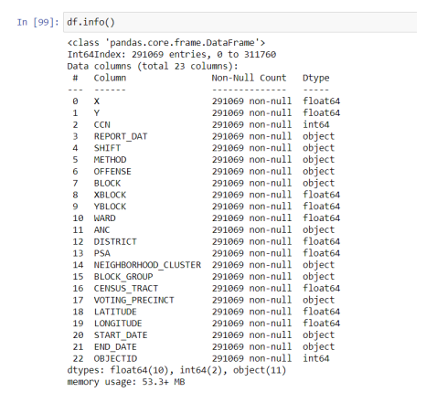
Machine learning models requires all input and output variables to be numeric.
Also dates are represented as object type, it should be converted into datetime datatype.
Data type Conversion:

Slide 19
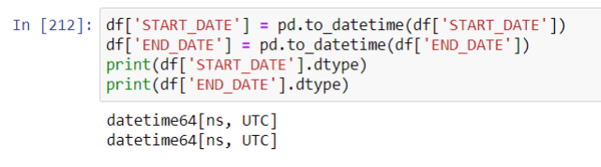
Converted dtype of
REPORT_DAT,
START_DATE and
END_DATE
from object to datetime64,
OFFENSE,
NEIGHBORHOOD_CLUSTER,
VOTING_PRECINCT
from object to int64

Slide 20
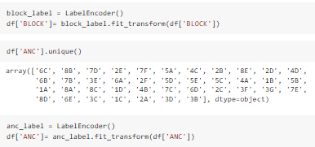
Applying LabelEncoder to BLOCK,ANC column, It will convert BLOCK and ANC from object to int32.

Slide 21
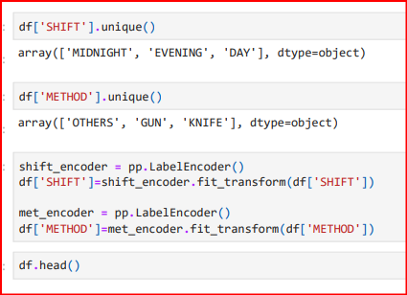
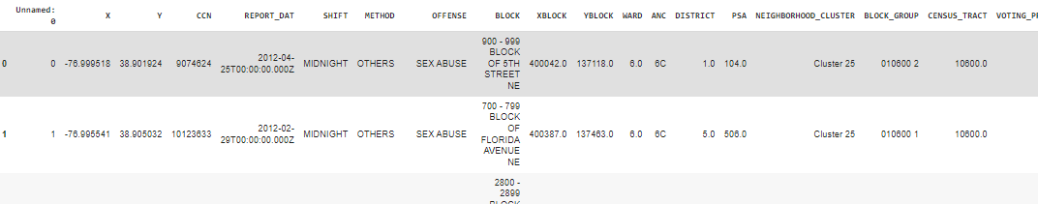
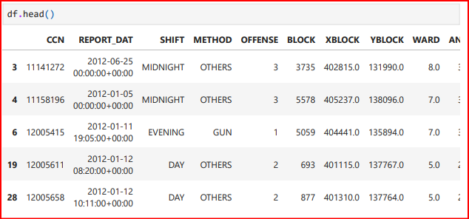
One Hot Encoding SHIFT and METHOD using get_dummies() function. It will create new columns with value 0 and 1 only.

Slide 22

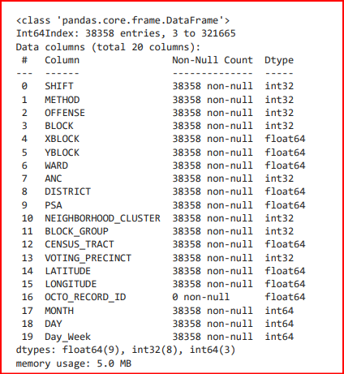
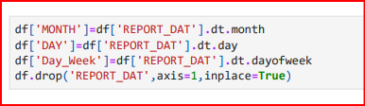
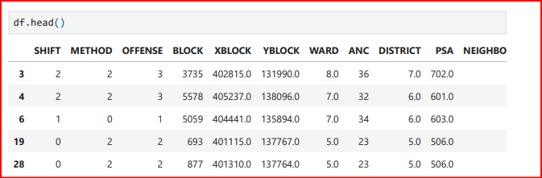

Converting to int
FINAL DTYPES
Dropping unwanted columns
Report date converted to month,day day of week.
FINAL DATASET

Slide 23
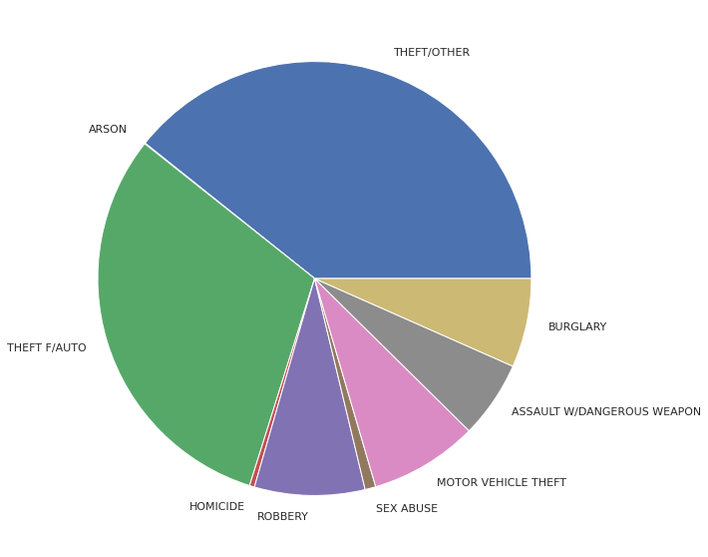
Data Visualisation
From this pie chart we can see that most of the crimes were Committed under the category THEFT/OTHER and THEFT F/AUTO

Slide 24
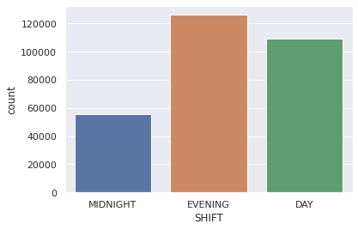
This countplot shows that most of the crime were committed during Evening. Day time had the 2nd largest crime count and Midnight had the least.

Slide 25
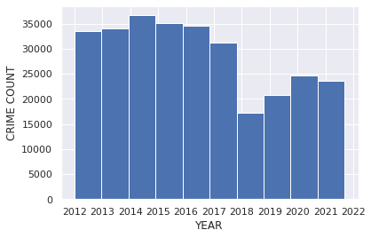
This histogram shows that until 2018, there is not much difference in crime rate. After that there is large decrease in crime rate and it is increasing each year.

Slide 26
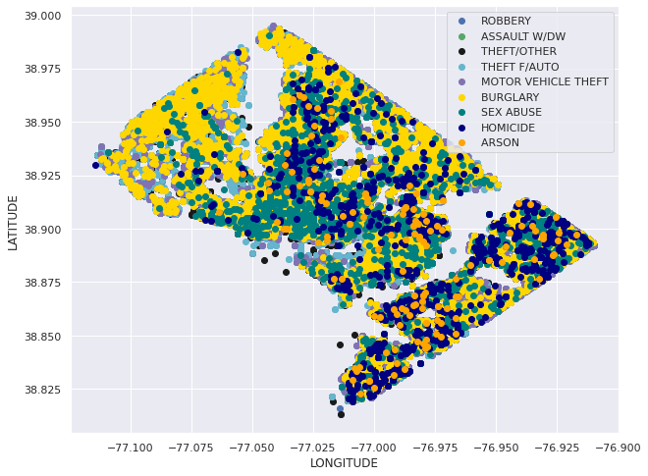
This scatter plot shows the latitude and longitude of different places where a particular type of crime had committed

Slide 27
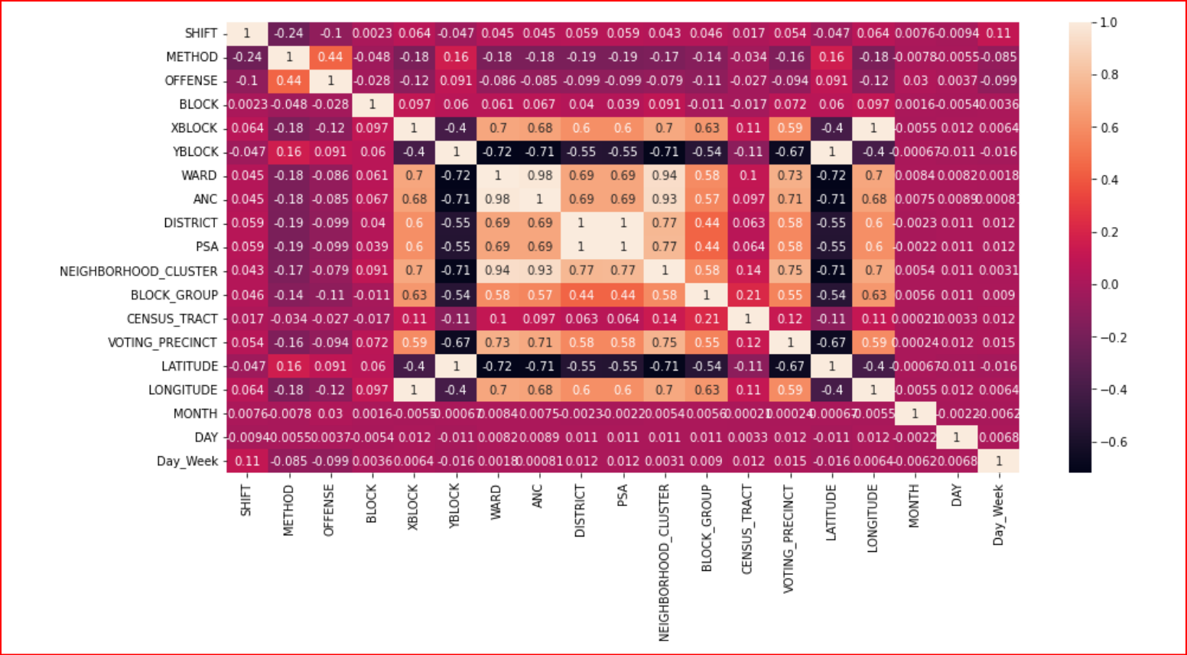
Heat Map

Slide 28
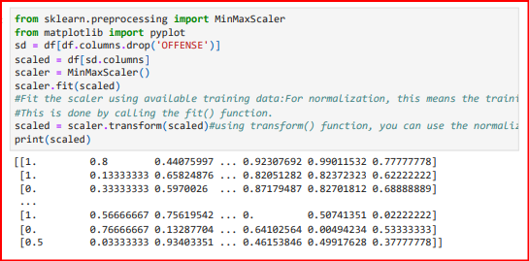
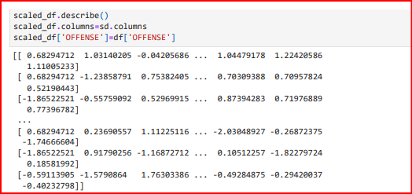
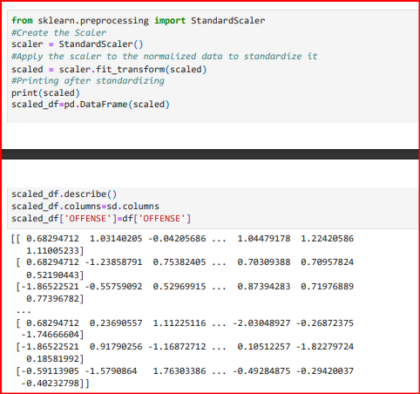
Normalization
Standardization

Slide 29
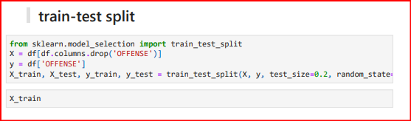
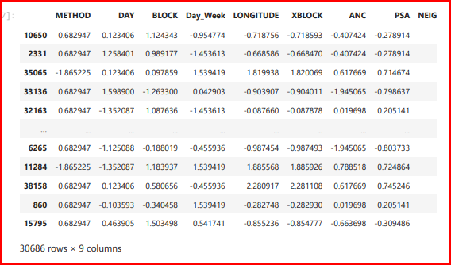
Splitting
Here we will divide the data set into train and test

Slide 30
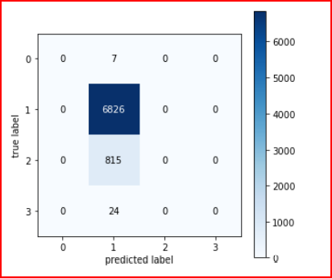
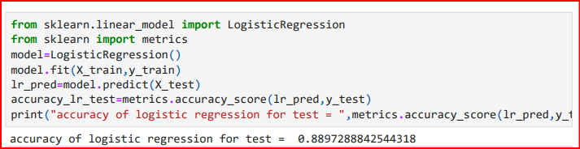
Algorithms Used
CONFUSION MATRIX
LOGISTIC REGRESSION
ACCURACY - 0.88972

Slide 31
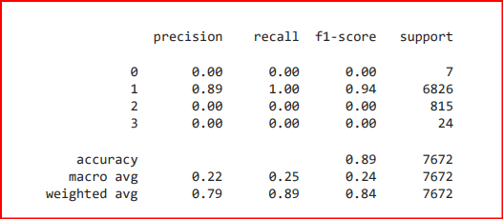
K-fold Cross Validation
ACCURACY - 0.89
ACCURACY REPORT
So we can say K-fold is better than logistic.

Slide 32
Thank You!

